Slide 1
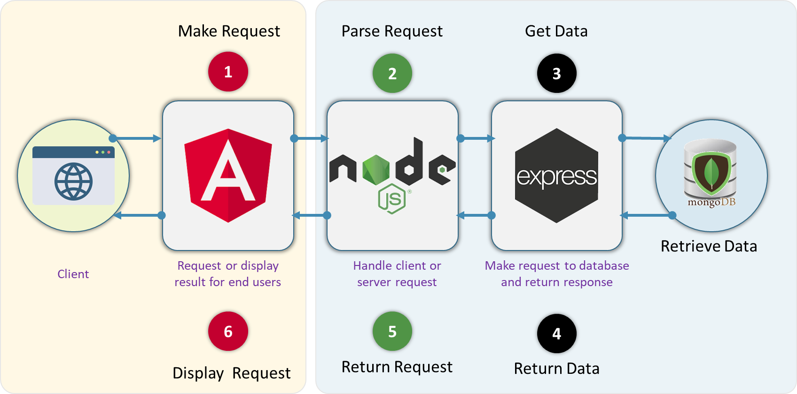
Arquitectura MEAN stack
VIII. Front-End Login-Registro

Slide 2
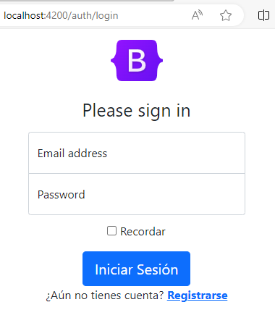
Componentes
Login
RegistroComponent

Slide 3
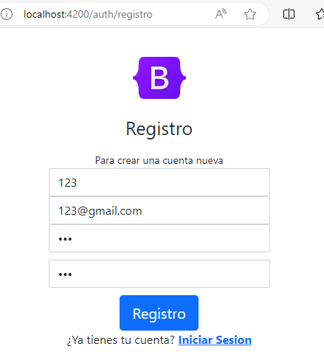
Componentes
Login
RegistroComponent

Slide 4
RouterLink
Rutas para el flujo de autenticación
import { NgModule } from '@angular/core';
import { RouterModule, Routes } from '@angular/router';
//--- Autenticacion
import { RegistroComponent } from './components/registro/registro.component'
import { LoginComponent } from './components/login/login.component';
import { AuthComponent } from './auth.component';
import { HomeComponent } from './home/home.component';
const routes: Routes = [
{ path: 'auth', component: AuthComponent ,
children:[
{path:'', component: HomeComponent},
{path:'login', component: LoginComponent},
{path:'registro', component: RegistroComponent}
]
}
];
@NgModule({
imports: [RouterModule.forChild(routes)],
exports: [RouterModule]
})
export class AuthRoutingModule { }

Slide 5
RouterLink
Rutas para el flujo de personal
import { NgModule } from '@angular/core';
import { RouterModule, Routes } from '@angular/router';
import { PersonalComponent } from './personal.component'
import { PersonalListComponent } from './components/personal-list/personal-list.component';
import { AgregarPersonaComponent } from './components/agregar-persona/agregar-persona.component';
import { EditPersonaComponent } from './components/edit-persona/edit-persona.component';
const routes: Routes = [
{ path: 'personal', component: PersonalComponent ,
children:[
{path:'', component: PersonalListComponent},
{path:'nuevo', component: AgregarPersonaComponent},
{path:'editar/:id', component: EditPersonaComponent}
]
}];
@NgModule({
imports: [RouterModule.forChild(routes)],
exports: [RouterModule]
})
export class PersonalRoutingModule { }

Slide 6
Dependencias
import { NgModule } from '@angular/core';
import { BrowserModule } from '@angular/platform-browser';
import { HttpClientModule } from '@angular/common/http';
import { ReactiveFormsModule } from '@angular/forms';
import { AppRoutingModule } from './app-routing.module';
import { AppComponent } from './app.component';
import { AuthModule } from './auth/auth.module';
import { PersonalModule } from './personal/personal.module';
@NgModule({
declarations: [
AppComponent,
],
imports: [
BrowserModule,
AppRoutingModule,
HttpClientModule,
ReactiveFormsModule,
AuthModule,
PersonalModule
],
providers: [],
bootstrap: [AppComponent]
})export class AppModule { }

Slide 7
Dependencias
import { NgModule } from '@angular/core';
import { CommonModule } from '@angular/common';
import { RouterModule, Routes } from '@angular/router';
import { FormsModule, ReactiveFormsModule } from '@angular/forms';
import { AuthRoutingModule } from './auth.routing';
//--Login
import { AuthComponent } from './auth.component';
import { LoginComponent } from './components/login/login.component';
import { RegistroComponent } from './components/registro/registro.component';
import { HomeComponent } from './home/home.component';
@NgModule({
declarations: [
AuthComponent,
LoginComponent,
RegistroComponent,
HomeComponent
],
imports: [
CommonModule,
RouterModule,
FormsModule,
ReactiveFormsModule,
AuthRoutingModule
],
exports:[
AuthComponent,
LoginComponent,
RegistroComponent
]
})
export class AuthModule { }

Slide 8
Dependencias
import { NgModule } from '@angular/core';
import { CommonModule } from '@angular/common';
import { RouterModule, Routes } from '@angular/router';
import { FormsModule, ReactiveFormsModule } from '@angular/forms';
import { PersonalRoutingModule } from './personal.routing';
import { PersonalComponent } from './personal.component';
import { PersonalListComponent } from './components/personal-list/personal-list.component';
import { PersonalFormComponent } from './components/personal-form/personal-form.component';
import { AgregarPersonaComponent } from './components/agregar-persona/agregar-persona.component';
import { EditPersonaComponent } from './components/edit-persona/edit-persona.component';
@NgModule({
declarations: [
PersonalComponent,
PersonalListComponent,
PersonalFormComponent,
AgregarPersonaComponent,
EditPersonaComponent,
],
imports: [
CommonModule,
RouterModule,
PersonalRoutingModule,
FormsModule,
ReactiveFormsModule
],
exports:[
PersonalComponent,
PersonalListComponent,
PersonalFormComponent,
AgregarPersonaComponent,
EditPersonaComponent
]
})
export class PersonalModule { }

Slide 9
Formularios
<form class="form-horizontal form-material" (ngSubmit)="login();" [formGroup]="loginForm" id="loginForm">
<!-- LOGIN -->
<h1 class="h3 mb-3 fw-normal">Please sign in</h1>
<div class="form-floating">
<input class="form-control" type="email" placeholder="Correo electrónico" formControlName="email">
<label for="floatingInput">Email address</label>
</div>
<div class="row">
<div class="col text-danger">
<p *ngIf="campoNoValido('email');"> El correo debe ser válido</p>
</div>
</div>
<button class="w-80 btn btn-lg btn-primary" type="submit">Iniciar
Sesión</button>
<div class="form-group m-b-0">
<div class="col-sm-12 text-center">
¿Aún no tienes cuenta? <a [routerLink]="['/auth/registro']"
class="text-primary m-l-5 cursor"><b>Registrarse</b></a>
</div>

Slide 10
Validación
import { FormBuilder, Validators } from '@angular/forms’;
public loginForm = this.fb.group({
email: ['', [Validators.required, Validators.email]],
password: ['', [Validators.required, ]]
})
formSubmit: boolean = false;
login() {
this.formSubmit = true;
if (this.loginForm.invalid) {
return;
}
console.log(this.loginForm);
console.log(this.loginForm.value);
this.usuarioService.login(this.loginForm.value)
.subscribe(resp => {
Swal.fire({
icon: 'success',
title: 'Bienvenido',
timer: 2000
});
this.router.navigateByUrl('/dashboard/perfil');
console.log(resp);
}, err => {
Swal.fire({
icon: 'error',
title: 'Error',
text: err.error.msg,
timer: 2500
})
})
}

Slide 11
Ejercicio. Implementar los formularios del flujo de Login-Registro
A partir del código desarrollado en los ejercicios anteriores realizar los siguientes cambios
Construir los componentes de Login y Registro
Habilitar las validaciones
Dividir el código en dos módulos: Autorización (auth) y Personal (personal)
ng generate component auth/auth –flat
NG generate module personal/personal --flat
https://github.com/fararoni/curso.mean/blob/main/resources/1-%20front-end-formularios-login-registro-ok.zip
Trasladar las rutas de Auth y Personal a sus respectivos módulos
Agregar un componente raíz para cada módulo
https://github.com/fararoni/curso.mean/blob/main/resources/2-%20front-end-formularios-modulos%20y%20ruta%20uno-ok.zip
Aactualizar las rutas en los tres módulos
https://github.com/fararoni/curso.mean/blob/main/resources/3-%20front-end-formularios-modulos%20-actualizacion%20de%20rutas-ok.zip
Actualizar los componentes con las nuevas rutas y agregar estilos bootstrap5
https://github.com/fararoni/curso.mean/blob/main/resources/4-%20front-end-formularios-actualizacion%20de%20la%20nevegacion.zip

Slide 12

Arquitectura MEAN stack
VII. Configuración Frontend

